Slide 1
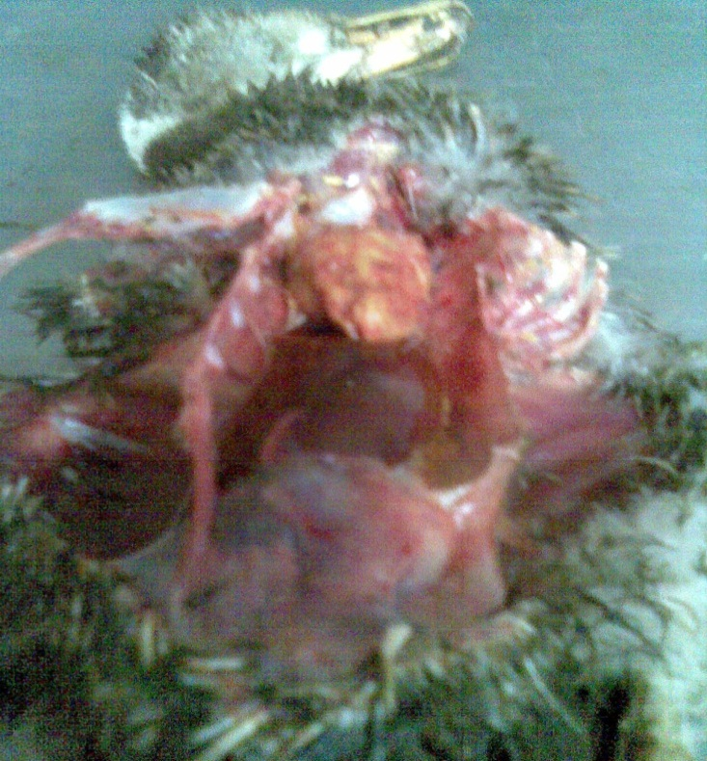
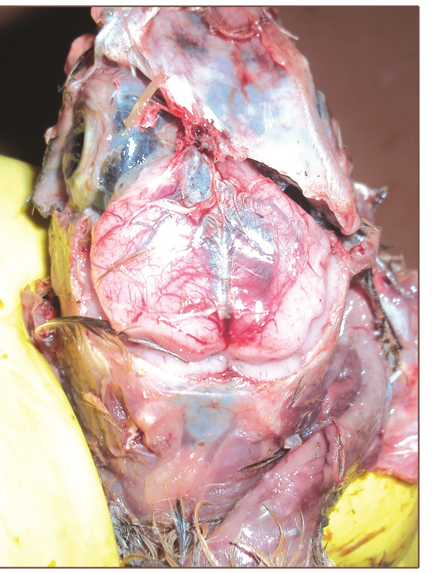
a
b
Fig 1
Gross lesions of (a) fibrinous pericarditis and b) congestion of meninges in R. anatipestifer affected ducklings

Slide 2
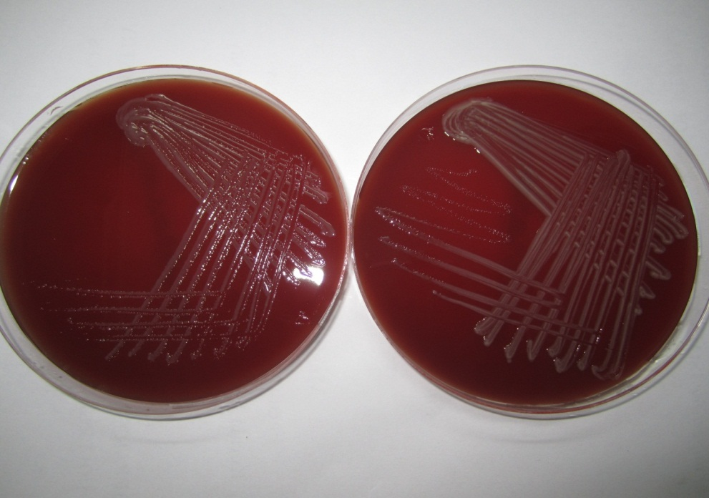
Fig 2
Mucoid, convex, greyish-white , non-haemolytic colonies of R. anatipestifer grown on sheep blood agar

Slide 3
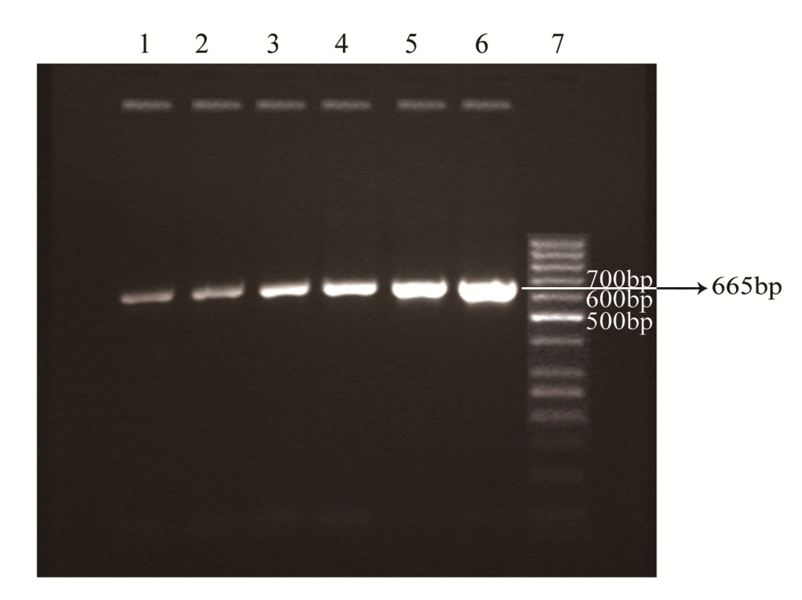
Fig 3
PCR amplified products of 16S rRNA gene confirming the presence of R. anatipestifer in all the six isolates. Lane 1: KAL-1, Lane 2: KNB-1, Lane 3: KML-1, Lane 4: KTL-1, Lane 5: KML-2, Lane 6: KML-3, Lane 7: 50bp ladder

