Slide 1
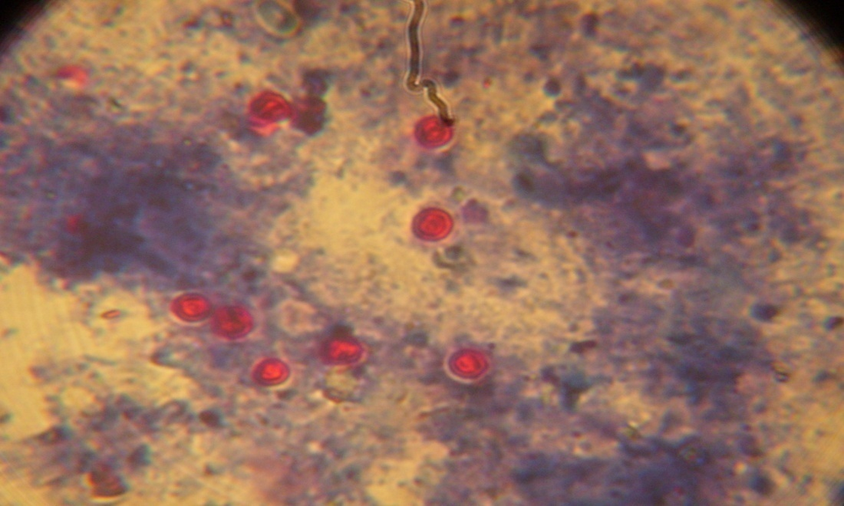
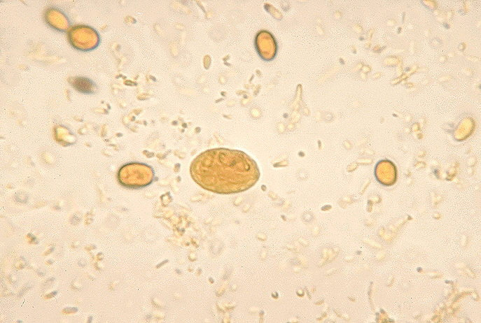
Cryptosporidium oocyst
Oocyst of Cryptosporidium (× 400) under microscope
Giardia cyst
Cyst of Giardia (×100) under microscope

Slide 2
Stratified random sampling
No | Township | Village | No. of Cattle | No. of Sample
1 | Yamethin | Ta Back Kar Shwe Dar Thar Si Shwe Dar Gue Khore The Kwe A Lai Khone In | 712 833 1,242 499 1,972 4,974 | 13 16 23 10 37 92
2 | Pyawbwe | Fat Taw Nyaung Shwe Ywa Ma Out Sar New Chaung Ma Gyi Yan Aung | 1,948 1,746 1,445 1,931 2,220 1,950 | 36 33 27 36 41 36
Total |  |  | 21,472 | 400

Slide 3
Number of faecal samples collected from Yamethin and Pyawbwe townships
No. | Age of cattle | No.of faecal samples collected from Yamethin township | No. of faecal samples collected from Pyawbwe township
1 | ≤5 months | 25(13%) | 31 (15%)
2 | 6 months – 2 year | 66 (35%) | 59 (28%)
3 | >2 year | 100(52%) | 119 (57%)
Total |  | 191 | 209

