Slide 1
Immunohistochemistry
Dr Mithilesh Singh (Scientist, SS)
Immunology Section
Indian Veterinary Research Institute
Izatnagar Bareilly-243122
India

Slide 2
Immunohistochemistry-what’s good about it?
IHC combines histological, immunological and biochemical techniques for the identification of specific tissue components by means of a specific antigen/antibody reaction tagged with a visible label.
IHC makes it possible to visualize the distribution and localization of specific cellular components within a cell or tissue.
Can be used to locate particular cells and proteins
Can be used to identify cellular events

Slide 3
What things can be targeted by IHC ?
1. Cytoplasmic antigen
2. Nuclear antigen
3. Cell membrane antigen
4. Lipids
4. Proteins
5. Replicating cells
6. Cell signaling
7. Apoptotic events
8. Different types of cells in a tissue
9. Cytoskeletal structure

Slide 4
How to perform it?
Broadly IHC consists of 3 steps:
Slide preparation
Slide staining (immunostaining)
Slide interpretation
IHC = histology + immunology + chemistry
Steps
1. Deparaffinization
2. Antigen (epitope) recovery
3. Quenching
4. Blocking
4. Primary antibody incubation
5. Secondary antibody incubation
6. Detection
7. Counter staining
8. Slide mounting

Slide 5
Fixation
Slide preparation
Sectioning
Aldehyde=10% NBF x 24-72 hours (best for good architecture)
Frozen = LN2
  Acetone or Methanol = best for cell membrane antigens, cytokines
  Paraffin = Most commonly used
  Frozen =
  Better survival of many antigens
  Poor morphology
  Poor resolution at higher mag
  Special storage
  Cutting difficulty

Slide 6
Deparaffinization
This is important to remove the excess paraffin from the tissue and usually done by using xylene.
Method: Dip the slide into xylene , 3 times, 5 minutes each followed by dipping into alcohol 100%, 95%, 85% & 75% successfully 2-3 min each. Final wash in water for 3 min.

Slide 7
Antigen (epitope) recovery
HIER
MW/steamer/pressure cooker ~ 20 minutes, slow cool
  Citrate, pH = 6.0
  Tris-EDTA, pH = 9.0
  EDTA, pH = 8.0
  Must determine for each new antibody/antigen target
PIER
  Proteinase K
  Trypsin
  Pepsin
  Pronase,etc.
  Destroys some epitopes
  Bad for morphology

Slide 8
Blocking
  Blocking unwanted tissue antigens (background staining) = Improves signal to noise by preventing Fc receptor binding
Specific
  Polyclonal antibodies – impure antigen used
  Inadequate fixation – diffusion of antigen – often worse in center of large block
Non-specific
  Non-immunologic binding – usually uniform
  Endogenous peroxidases (eliminate with H202)
  Endogenous alkaline phosphatase
  Endogenous biotin

Slide 9
Antibody incubation
1. Direct Method 2. Indirect Method
Secondary Antibody
Labeled Antibody
Primary Antibody
Tissue Antigen
Tissue Antigen

Slide 10
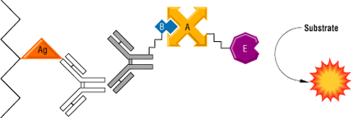
PAP Method (Sternberger et al)
ABC/SP Method

Slide 11
Counterstaining & Slide mounting
  Counter stain provides the contrast that helps the primary stain stand out.
  Many counter stain show specificity for discrete cellular compartments while others will stain the whole cell.
  Slide mounting is a process of preserving the completely stained slides for future work or to prevent enzymatic product solubilization or fluorophore photobleaching.
  Slide interpretation is vital step in IHC test which is done by examining the slide under the appropriate magnification of light microscope.

Slide 12
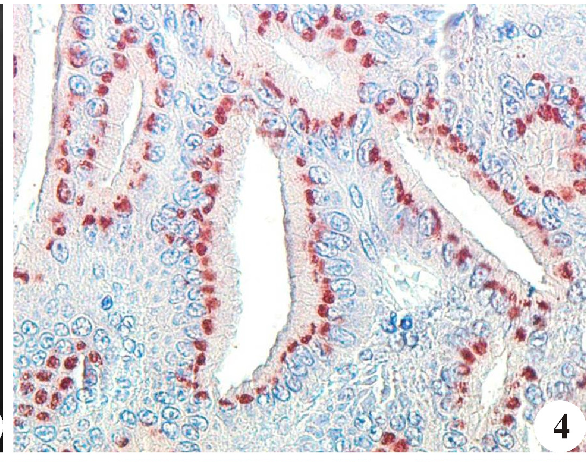
Factors affecting IHC
  Specimen fixation
  Duration of fixation
  Specimen processing
  Antigen retrieval method
  Concentration of antibodies used
  Detection system

Slide 13
Application of IHC
  Disease diagnosis
  Determination of the function of specific gene products
  Drug development & its safety

