Slide 1
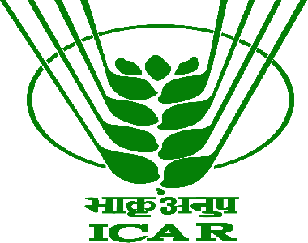
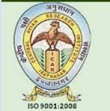
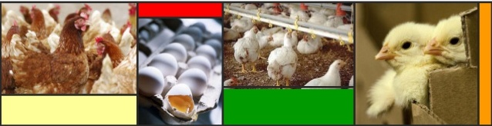
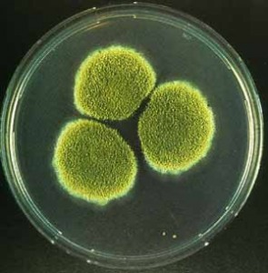
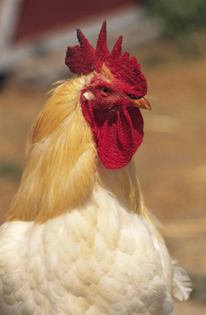
Major credit
Seminar
on
Recent advances in control of mycotoxins
in broilers
T.TAMILMANI
P-2032

Slide 2
Introduction
Types of mycotoxins
Economic impacts
Adverse effects of mycotoxins in poultry
Management
Control strategies for mycotoxins & mycotoxicosis
Conclusion
Research works done in CARI

Slide 3
Introduction
Mycotoxins
Mycotoxins are biologically active, toxic metabolites produced by toxigenic fungi mainly belonging to Aspergillus, Fusarium and Penicillium species.
Which invade crops in the field and may grow on foods during storage under favourable conditions of temperature and humidity.
(Shamsudeen et al., 2013)

Slide 4
Mycotoxins significantly affecting poultry
Mycotoxins | Moulds
Aspergillus toxins
Aflatoxins B 1, B 2,G 1 and G 2 | Aspergillus flavus and Aspergillus parasiticus
Cyclopiazonic acid | Aspergillus flavus
Ochratoxins | Aspergillus ochraceus
Sterigmatocystin | Aspergillus versicolor
Pencillium Toxins
Ochratoxins | Penicillium viridicatum
Citrinin | Pencillium citrinum
Fusarium Toxins
T-2 Toxin, Diacetoxyscirpenol (DAS), Deoxynivalenol (DON, vomitoxin) | Fusarium tricinctum, Fusarium graminearum Fusarium solani
Fumonisins B 1, B 2 | Fusarium moniliforme , Fusarium proliferatum
Moniliformin | Fusarium moniliforme
Zearalenone | Fusarium graminearum, Fusarium roseum
(IPSACON,2005)

Slide 5
Economic impacts
FAO estimated that about 25% of human foods and animal feeds are contaminated with mycotoxins.
(Huwig et al., 2001; Yiannikouris and Jouany, 2002; Shetty and Jespersen, 2006).
Mycotoxins adversely affect the health and productivity in animals and poultry. (Zain, 2011; Katole et al., 2013).
In India, the economy of poultry industry is heavily affected due to mycotoxins.
The losses are due to decrease in growth rate, feed conversion efficacy, carcass yield, carcass quality, immuno-suppresion and increase carcass condemnation.
                (Patil et al., 2013)

Slide 6
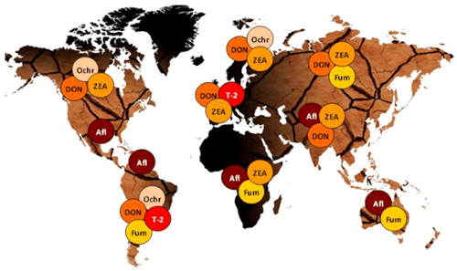
Global mycotoxins contamination profile
Sandrine Durox 2016

Slide 7
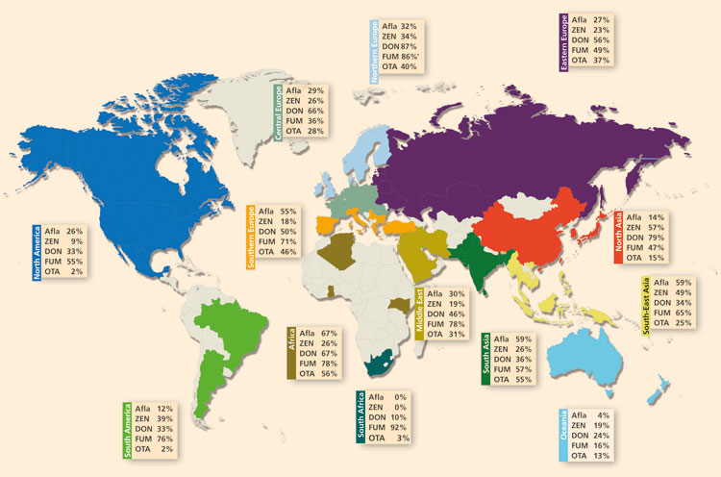
Prevalence of mycotoxins in different geographic regions
(Biomin survey 2014)

Slide 8
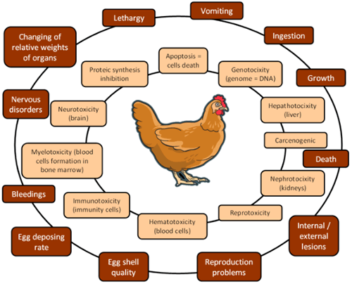
Adverse effects of mycotoxins in poultry
Sandrine Durox 2016

Slide 9
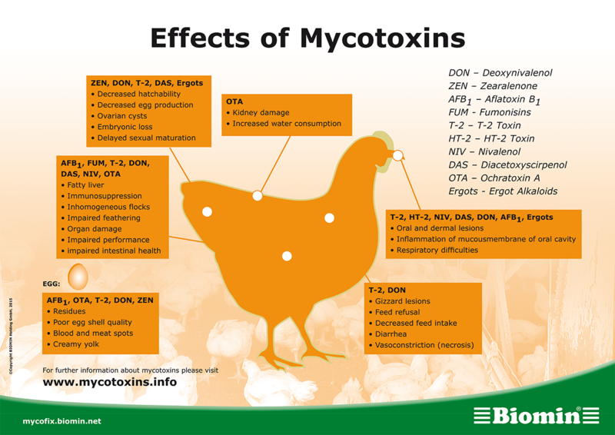
Adverse effects of different mycotoxins
Contd...
Source Biomin.

Slide 10
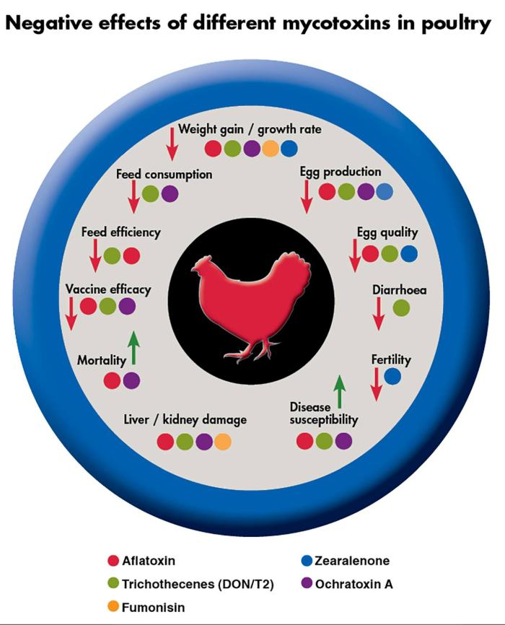

Slide 11
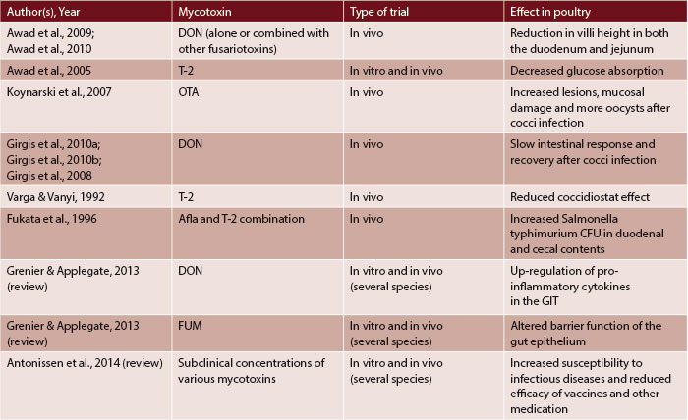

Slide 12
Management
Mycotoxin screening
Routine analysis of feed ingredients.
Mycotoxin detection: the methods include
1) Microcolumns
2) Thin Layer Chromatography (TLC)
3) Enzyme Linked Immuno-Sorbent Assay (ELISA)
4) High Pressure Liquid Chromatography (HPLC)
5) Gas Chromatography
6) Tandem Gas Chromatography/Mass Spectrophotometry
The TLC and ELISA methods are relatively easy and rapid technologies for mycotoxin detection in contaminated feed/food.
(Asrani et al., 2013)

Slide 13
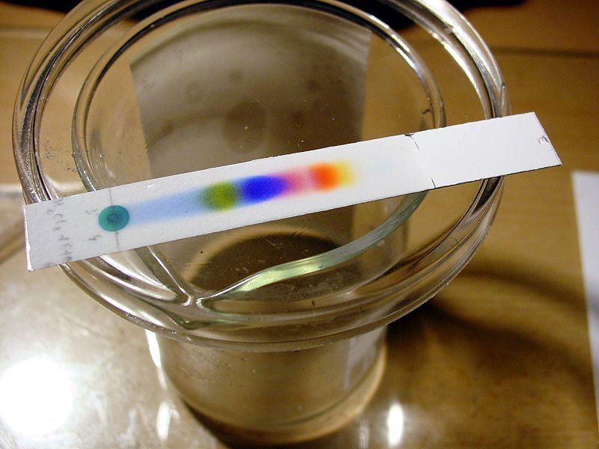
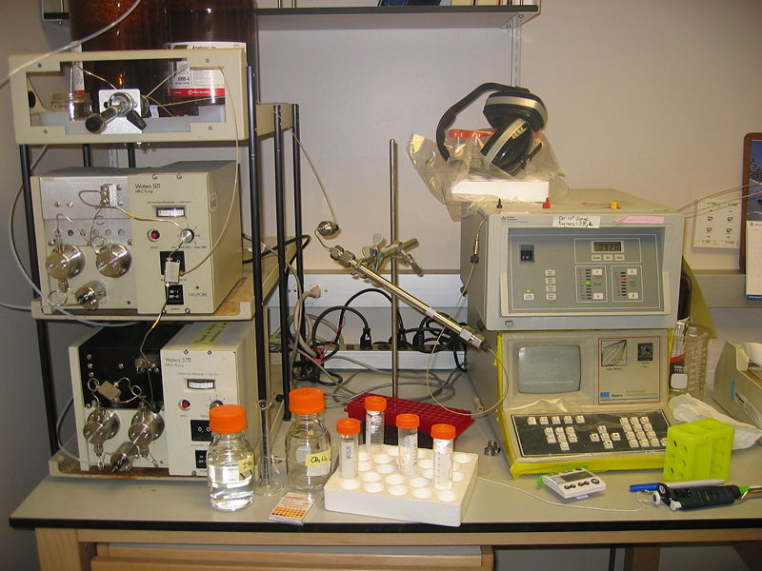
Types of tests for mycotoxins
TLC
1.Quick Test (Qualitative)
Immunochromatographic strip
Thin Layer Chromatography (TLC)
Immunoassays (ELISA)
Use: Detects Specific Mycotoxin
Limited range
2. Confirmatory Tests (Quantitative)
High Pressure Liquid Chromatography(HPLC)
(Requires well trained technicians and equipment)
Use: Determines level of mycotoxins
Detect several mycotoxins
HPLC

Slide 14
Managemental approach contd..
2. Moisture/Temperature
Bulk storage bins of grains must be well ventilated, and the materials must be protected from rain and wide fluctuations of temperatures.
Moisture level of grains should be kept at below 11%.
Mycotoxins produced by Aspergillus spp. are not likely to be produced at temperatures below 5 to 8⁰C.
3.Cleaning:
Periodic cleaning of all feed handling equipments with 5 to 10% bleach solution.
4.Feed holding time
Withdrawal of mycotoxin contaminated feed/feed ingredients or change of feed.

Slide 15
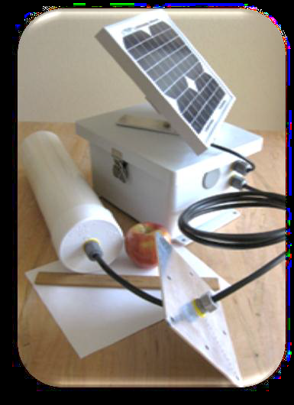
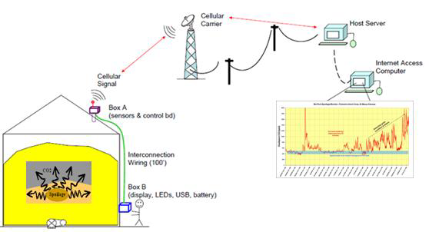
The CO2 sensing technology
The CO2 sensor is inserted through the grain storage bin’s roof and suspended into the headspace. The CO2 sensor is connected to the communication box through a cable. The CO2 sensor automatically records the CO2 concentration hourly, and depending on the settings sends the data to a server via the wireless telephone network.

Slide 16
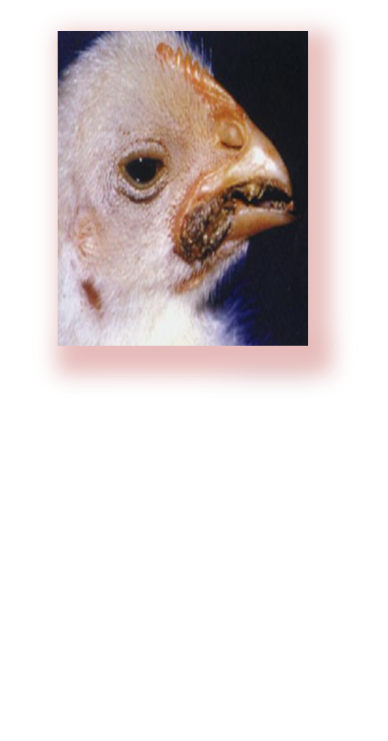
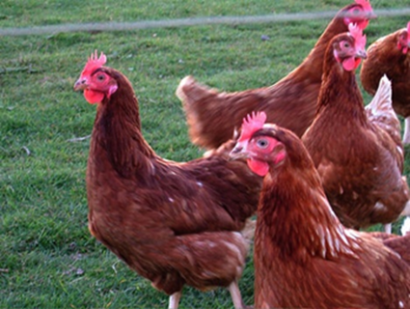
Control strategies for mycotoxins or mycotoxicosis
Preventive measures
Decontamination/detoxification of aflatoxins
        1. Physical methods
        2. Chemical detoxification
Amelioration/ Biological Inactivation
Dietary manipulations
Natural and practical solutions– recent biotechnological approaches

Slide 17
Preventive measures
Pre harvest
Harvest
Mycotoxins
Post harvest

Slide 18
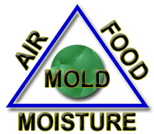
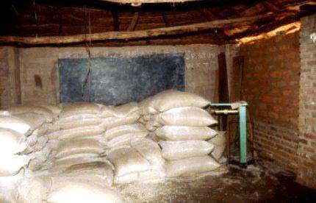
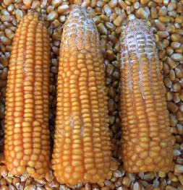
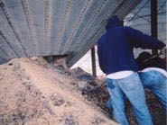

Slide 19
Mycotoxin decontamination methods
1.Physical methods
Antimycotic agents:
Sorbic acid and sorbate; propionic acid and propionate, benzoic acid, benzoates and parabens; and acetic acid and its derivatives.
1% propionic acid inhibits mycotoxigenic A. flavus, A. parasiticus, A. ochraceus and P. viridicatum and mycotoxin production in stored corn.
Potassium sorbate was very effective and completely inhibited aflatoxin and ochratoxin production at the levels 0.1 to 0.2% and 0.10 to 0.15 %, respectively.
                (Vandegraft et al., 1975).

Slide 20
Physical methods contd..
Herbs and spices like cloves, cinnamon oil, mustard, allspice, garlic and oregano have been shown to have strong antimycotic properties (Bullerman et al., 1977).
Low oxygen concentration (<1%) and/or increased concentrations of other gases (i.e., 90% CO2) depress mould growth and mycotoxin formation.
2. Density segregation: Density segregation of contaminated grain and oilseeds involves sorting and delineating good versus contaminated kernels by floatation..

Slide 21
Physical methods contd..
3. Irradiation
Gamma or electronic irradiation and Fluorescent or ultraviolet (UV) rays decompose aflatoxins and ochratoxins.
4. Mechanical separation: by hand or machine
5. Processing of food: Autoclaving at 132⁰C for 5 hours reduces the OTA concentration by 85 %. (Madsen et al., 1983).
6. Solvent extraction: Most mycotoxins can be extracted efficiently from contaminated grains using carefully selected solvent mixtures.

Slide 22
Chemical detoxification
1.Ammoniation:
Detoxifies several mycotoxins (85-100%) and inhibits mould growth. (Madson et al., 1983).
2.Ozonization: Ozone (O3) gas, degrades aflatoxins in corn and cottonseed meals and also degrades deoxynivalenol and moniliformin.
3. Sodium hydroxide: Warming of grain to 105⁰C in the presence of 0.5% sodium hydroxide detoxified various mycotoxins in the feed.
4. Structural degradation: Chemicals including acids, bases, aldehydes, bisulfites, oxidising agents and various gases have been tested for their ability to degrade or detoxify AFB1 and other mycotoxins.

Slide 23
Biological Inactivation
  The commercial available synergistic blends of the mycotoxin binders are found to be beneficial against the commonly occurring mycotoxins in poultry species. (Patil et al., 2005).
  1.Activated charcoal:
  The adsorption property of AC was found effective against aflatoxin B1 and ochratoxin A up to 95% and 91%, respectively, during in vitro studies (Galvano et al., 2001)
  2. Bentonites
  Bentonite could bind aflatoxin to the extent of 66% while it was of little use in adsorbing OTA.
  3. Bovine serum albumin
  Bovine albumin competes with mycotoxins in the intestinal tract and helps to excrete it.

Slide 24
Biological Inactivation contd...
4. Cholestyramine
CHA at (5%) reduced the concentration of OTA in plasma (50%) and increased its clearance by way of the faeces. (Kerkadi et al., 1998)
5. Hydrated sodium calcium alumino silicate (HSCAS)
In young broiler chicks, HSCAS (0.5%) was effective at reducing the toxicity of aflatoxin (Harvey et al., 1993; Abo-Norag et al., 1995) as well as combined toxicity with OTA (Huff et al., 1974).
6. Polyvinylpolypyrrolidone
Polyvinylpolypyrrolidone, a synthetic resin, at 0.4g/kg level can bind up to 50 g/kg of AFB1 in feed.

Slide 25
Binders
Types of Binders
Organic products
Dioctatin A, aflastatin A, dillapiol, indigestible carbohydrates (cellulose, glucomannas, peptidoglycans), etc.
Dioctatin A, Dillapiol, aflastatin-A, and Apiol as specific inhibitors of biosynthesis of aflatoxin G1 in Aspergillus parasitics
Inorganic products
Activated carbon, aluminosilicates (clay, bentonite, montmorillonite, seolite, phyllosilicate etc.), Polyvinylpyrollidine (PVP), montmorillonite, etc.
Hydrated sodium calcium aluminosilicate (HSCAS)
Mostly studied one, “aflatoxin-selective clay”

Slide 26
Microbiological binding agents
MOS Saccharomyces cerevisiae has shown broad-spectrum efficacy against most of the mycotoxins (Raju and Reddy, 2000)
MOS with glucan, bound AFB1 and showed significant binding over zearelenone, T2 toxin and moderate binding over OTA , during in vitro studies (Raju and Reddy, 2000).
Bifidobacteria, Lactic acid bacteria and Propionibacteria can bind mycotoxins (Yoon and Baeck 1999; ElNemazi et al., 1998)
Bifidobacter animalis and Lactobacillus acidophilus were found to be highly effective against OTA and patulin, respectively (Fuchs et al., 2008).

Slide 27
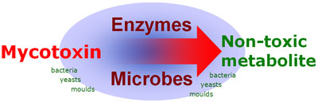
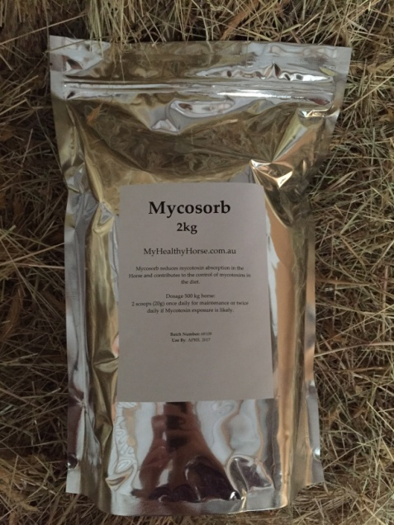
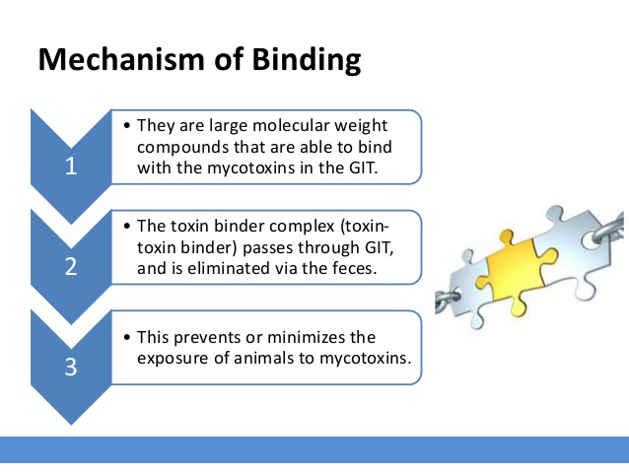
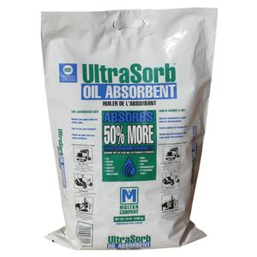

Slide 28
Antioxidant substances and food components and additives
Superoxide anion scavengers, thereby protecting cell membranes from the mycotoxin induced damage.
Ascorbic acid (Vitamin C)
Phenolic compounds
Plant materials/Plant product
Vitamin A
Vitamin E/Selenium
food components and additives
Aspartame
Crude proteins
Dietary lipids
L-Methionine
L- Phenylalanine (Patil et al., 2005).

Slide 29
Research works done in CARI
1. Sirajudeen, M., Gopi, K., Tyagi, J.S., Moudgal, R.P., Mohan, J. and Singh, R., 2011. Protective effects of melatonin in reduction of oxidative damage and immunosuppression induced by aflatoxin B1‐contaminated diets in young chicks. Environmental toxicology, 26(2), pp.153-160.
2.Singh, R., Shrivastava, H.P., Shrivastav, A.K. and Deo, C., 2010. Effect of varying levels of dietary aflatoxin on the performance of broiler chicken. Indian Journal of Poultry Science, 45(3), pp.308-310.
3.Awachat, V.B., Majumdar, S., Mandal, A.B. and Bhanja, S.K., 2011. Slaughter byproduct yields of poultry, their rendering into poultry byproduct meal, and evaluation of its nutrient composition and aflatoxin content. Animal Science Reporter, 5(4), pp.135-140.
4..Singh, R. and Shrivastav, A.K., 2011. Occurrence of aflatoxins in maize feed in Bihar. Indian Journal of Poultry Science, 46(3), pp.341-345.
5.Singh, R., Shrivastava, H.P. and Shrivastav, A.K., 2011. Effect of dietary aflatoxin on the performance of turkey poults. Indian Journal of Poultry Science, 46(2), pp.185-188.

Slide 30
Cont..
6.Silambarasan, S., Singh, R. and Mandal, A.B., 2013. Evaluation of the ability of adsorbents to ameliorate the adverse effects of aflatoxin B1 in broiler chickens. The Indian Journal of Animal Sciences, 83(1).
7.Sharma, M., Singh, R., Mandal, A.B. and Kurade, N.P., 2014. Amelioration of aflatoxicosis by methionine supplementation in broiler chickens. Indian Journal of Poultry Science, 49(1), pp.1-6
8.Singh, R. and Mandal, A.B., 2014. Efficacy of fumaric and citric acids in preventing biosynthesis of aflatoxins in poultry feed with variable moisture content. The Indian Journal of Animal Sciences, 84(4)
9.Singh, R. and Mandal, A.B., 2015. Efficacy of Methionine Hydroxy Analogue in Ameliorating Aflatoxicosis in Japanese Quails. Animal Nutrition and Feed Technology, 15(2), pp.227-234.
10. Singh, R., Mandal, A.B., Sharma, M.A.M.T.A. and Biswas, A.V.I.S.H.E.K., 2015. Effect of varying levels of dietary ochratoxin A on the performance of broiler chickens. The Indian Journal of Animal Sciences, 85(3), pp.296-300.

Slide 31
Conclusion
The most appropriate practices for mycotoxin control are :
Prevention of fungal growth on crops in the field, at harvest of crop, during storage of feedstuffs and processing of feed.
Time to think is not when production is at its lowest but at the time of purchase of raw materials, storage etc., so that mycotoxin levels can be limited to a minimum.
Application of appropriate mycotoxin binder along with appropriate nutritional supplementation in order to achieve good productivity and profitability.

Slide 32
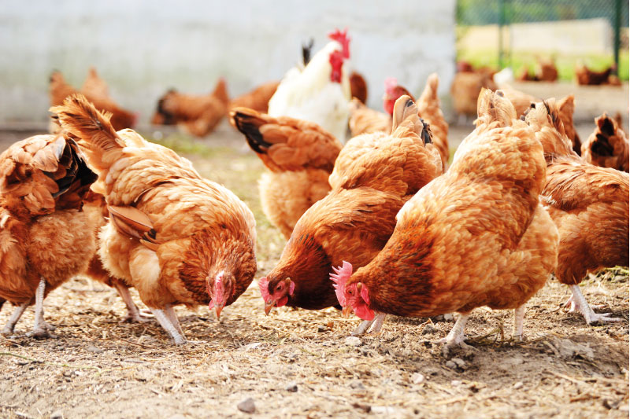
Thank You

