Slide 1
Salmonella
Food poisoning; Enteric fever and Gastroenteritis

Slide 2
Bacteriology
Salmonella enterica
  one species, ~2000 serotype
    S. enterica serotype typhimurium or S. typhimurium
Rod-shaped, non-spore-forming Gram-negative bacterium
Belongs to the family Enterobacteriaceae
  close relative of E. coli
Motile by peritrichous flagella (H antigen).
  Non motile exceptions: S. gallinarum and S. pullorum

Slide 3
Salmonella infections in humans
Enteric fever
  Typhoid and paratyphoid fevers
  S. typhimurium, S. paratyphimurium
  Systemic infection
  Infects only humans
Gastroenteritis
  Non-typhi serotypes
  Zoonosis: predominantly food-borne
  Can be complicated by septicaemia
    more common with some serotypes, e.g. S. dublin (15% mortality rate when septicaemia in the elderly)

Slide 4
Epidemiology of Enteric fever
Person-to-person spread
  No animal reservoir
Contamination with human faeces
  Usual vehicle is contaminated water – major source
  Occasionally, contaminated food (usually handled by an individual who harbours S. typhimurium)

Slide 5
Epidemiology of Non-typhoidal serotypes
Zoonosis with enormous animal reservoir
  Common animal reservoirs are chickens, turkeys, pigs, and cows
Contaminated food is major vehicle, usually:
  Meat, raw eggs, milk & dairy products
  Can follow direct contact with infected animals

Slide 6
Salmonella in eggs
Various Salmonella serotypes have been isolated from the outside of egg shells
S. enteritidis present inside the egg, in the yolk
Vertical transmission
  Deposition of the organism in the yolk by an infected layer hen prior to shell deposition.

Slide 7
Infectious dose
Typically about 1,000,000 bacteria
Much lower if the stomach pH is raised
Much lower if the vehicle for infection is chocolate
  Protects the bacteria in their passage through the stomach
  An infectious dose of about 100 bacteria

Slide 8
Clinical Features; Enteric Fever
Incubation period 10 to 14 days
Septicaemic illness
  Myalgia and headache
  Fever
  Spleenomegaly
  Leukopenia
  Abdominal pain
  Rose spots (macular rash on abdomen)
10% fatal
Sequelae (secondary result ): intestinal haemorrhage and perforation

Slide 9
Clinical features; Gastroenteritis
Incubation period depends on dose
Symptoms usually begin within 6 to 48 hours
  Nausea and Vomiting
  Diarrhoea
  Abdominal pain
  Myalgia and headache
  Fever
Duration varies, usually 2 to 7 days
Seldom fatal, except in elderly or immunocompromised

Slide 10
Laboratory diagnosis
Specimens
Blood, urine & feces for culture
Blood – detected in 75-90% of the patients in the first 10 days of infection, and 30% of the patients in the 3rd week
Faeces – can be isolated from 40-50% of patients in the 2nd week of infection & from about 80% of patients in the 3rd week
Urine – isolated from about 20% of patients after the 2nd week of infection

Slide 11
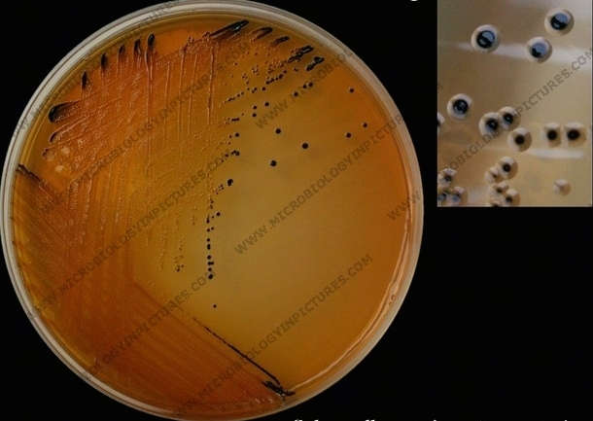
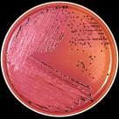
Laboratory Diagnosis
Enrichment and selective media for Salmonella in faeces is Selenite broth
Differential media is XLD and SSA
XLD-pink colonies with black centers
SSA- black colonies with silver metallic sheen.

Slide 12
Laboratory Diagnosis
Biochemical tests and serological tests
  Some other bacteria, e.g. Citrobacter, may have similar serological profiles
  Commercial kits commonly used, e.g. API20
  O, H serum analysis kits
Typing done for epidemiological purposes
  To find source of outbreak

Slide 13
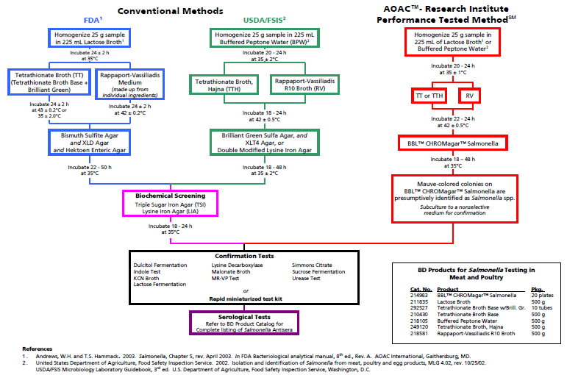

Slide 14
Widal Test
O & H antibodies in the patients serum and comes in handy when culturing facilities are not available.

Slide 15
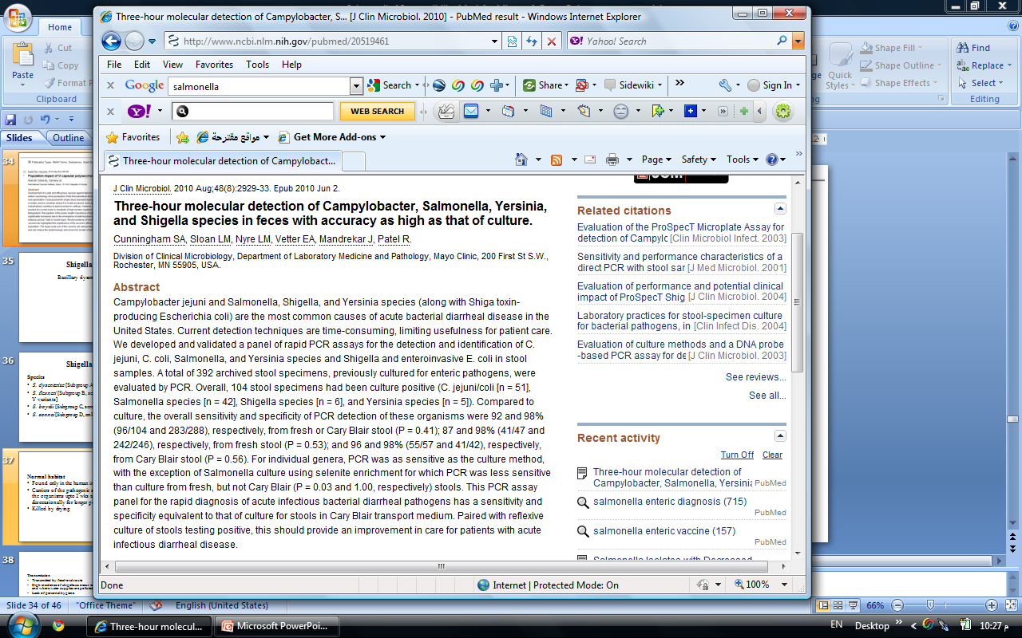

Slide 16
Treatment
Gastroenteritis
  Replace fluid loss by oral and intravenous routes
  Antibiotics are not recommended for uncomplicated gastroenteritis
    do not shorten illness
    prolong excretion
  Antibiotic therapy reserved for the septicaemia
Typhoid fever and enteric fevers should be treated with antibiotics
  Usually ciprofloxacin; however, the concern issue is resistance

Slide 17
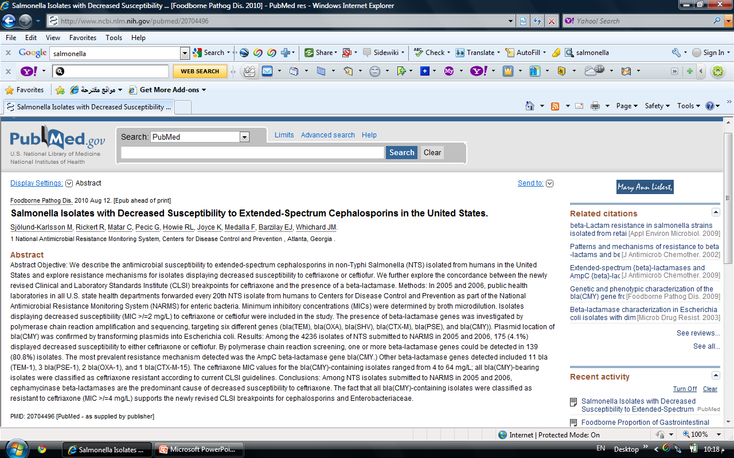

Slide 18
Prevention
Public awareness
Remove source
  Salmonella free chicks/livestock
Interrupt transmission
  Good food hygiene
    Cook food properly
    Keep raw and cooked foods apart
  Public Health: clean water
Strengthen host
  Vaccination

Slide 19
Salmonella vaccines
Vaccination of travellers against typhoid recommended, but does not remove need for good hygiene
Three licensed vaccines
  Traditional heat-killed
    very reactogenic
  Vi subunit vaccine
  live oral vaccine, S. typhi Ty21A
No vaccines for gastroenteritis

Slide 20
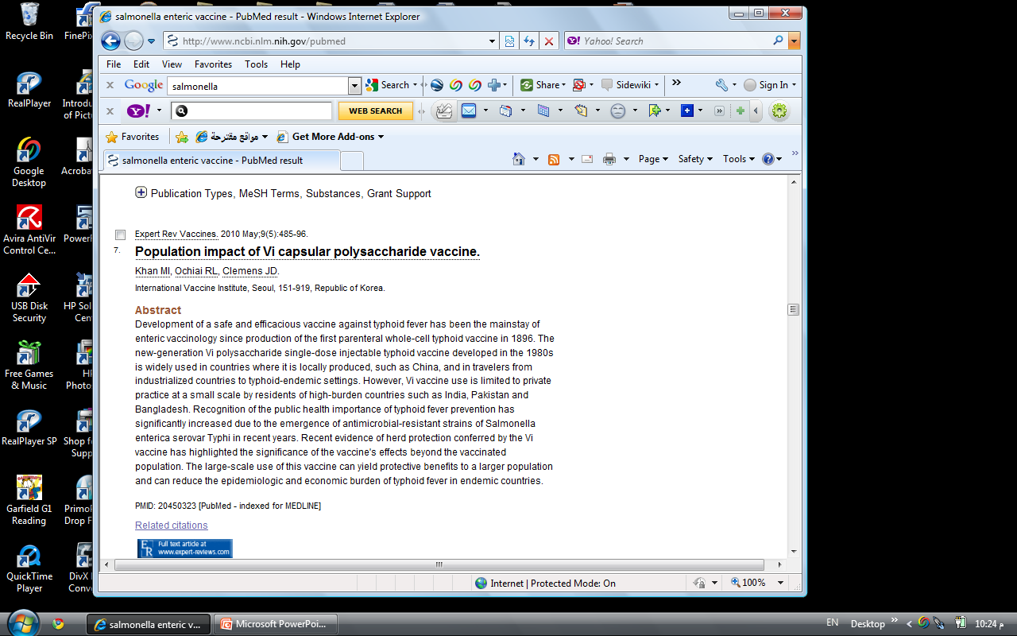

Slide 21
Thanks

